Slide 1

FORCE MODELING FOR OBLIQUE CUTTING ON NON-PLANAR SURFACES
Department of Mechanical Engineering
Dual degree project
22-6-2017
Submitted By: Ayush Bandil Guide: Prof. Anirban Guha & Prof. Asim Tewari

Slide 2
INTRODUCTION
Extremely tight tolerance limit is required in Industries like aerospace and automotive
Limitations of conventional 3-axis milling processes:
Tolerance limit: High forces result in tool bending
Tool wear: Quality
Tool accessibility: free form surfaces

Slide 3
INTRODUCTION
Two major groups:
1) Y. Altintas:
Orthogonal Cutting Data for Ti₆Al₄V (1995): Experimental
3-Axis Milling for Ball-End Milling tool (1998)
3-Axis Milling for Multiple tool (2001)
5 Axis-Feed Optimization (2008), trajectory shaping (2014), Chattering effect (2016)
2) Ehran Budak: (Sabanci University)
Modelling of 5-Axis Milling forces (2005)
Inconel 718 alloy machining performance for 5-Axis Milling (2013)

Slide 4
PROJECT OBJECTIVE AND MOTIVATION
Overall aim: General methodology to predict the cutting forces during the 5-axis milling process for:
Any tool geometry
Any feed direction
Any workpiece geometry (edges, corners, step etc.)
Allows surface roughness determination (for machining time optimization)
(Most models exist for ball-end milling tool, horizontal feed and planar surfaces)

Slide 5
- Lead and tilt
Normal
Feed
tilt
lead
Cross feed

Slide 6
- Different coordinate systems
Normal
z
Feed
y
tangential
radial
axial
Cross feed
x

Slide 7
GEOMETRICAL MODELLING OF BALL-END MILL
Step 1
Mathematical formulation of the Tool Envelope
Discretization of Surface Points
Step 3
Identification of the Engagement Region
Step 4
Defining chip dimensions
Step 5
Computation of forces and torque
Step 2

Slide 8
Different Types of Models Developed
Model 1: Ball-End Mill Cutting Planar Surface having only Horizontal Feed
Model 2: Ball-End Mill Cutting Planar Surface
Model 3: General Milling Tool Cutting Planar Surface
Extensions
Non-planar surfaces
Surface Roughness

Slide 9
Flow of WinForms
Tool Selection Form
Tool Parameters Form
Select Surface Form
Tool Initial Position and Machining Parameters
Task Selection Form
- Code written in C# using IDE Microsoft Visual Basic Studio
- 6000+ lines
-Generate Custom Surface
-Get Forces and Torque
-Get Lead and Tilt
-Get Engagement Region
-Step Over
-Generate Tool Profile

Slide 10


Slide 11
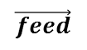
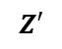

Model 1: Ball-End Mill Cutting Planar Surface having only Horizontal Feed
$$Z′$$
$$\vec{feed}$$
$$Cutting depth$$

Slide 12
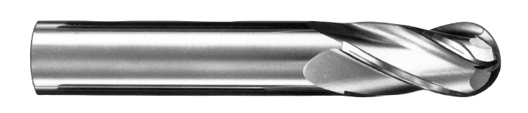
Ref: http://www.sgstool.com/images-dev/_products/series-1b.jpg

Slide 13
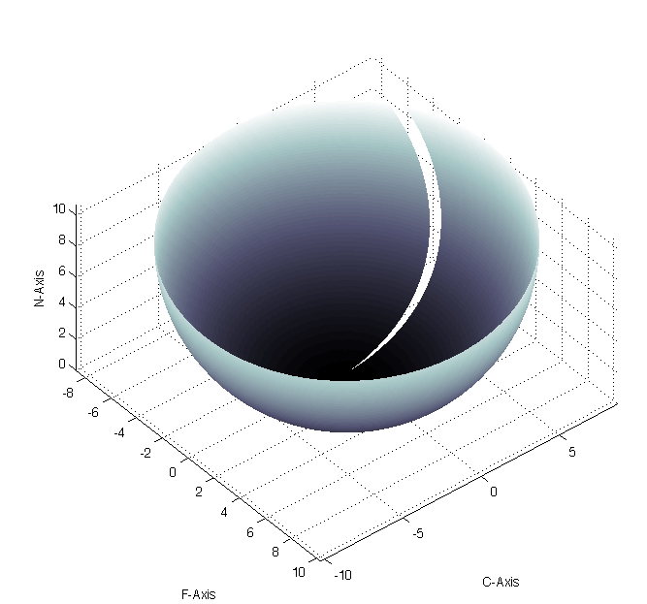
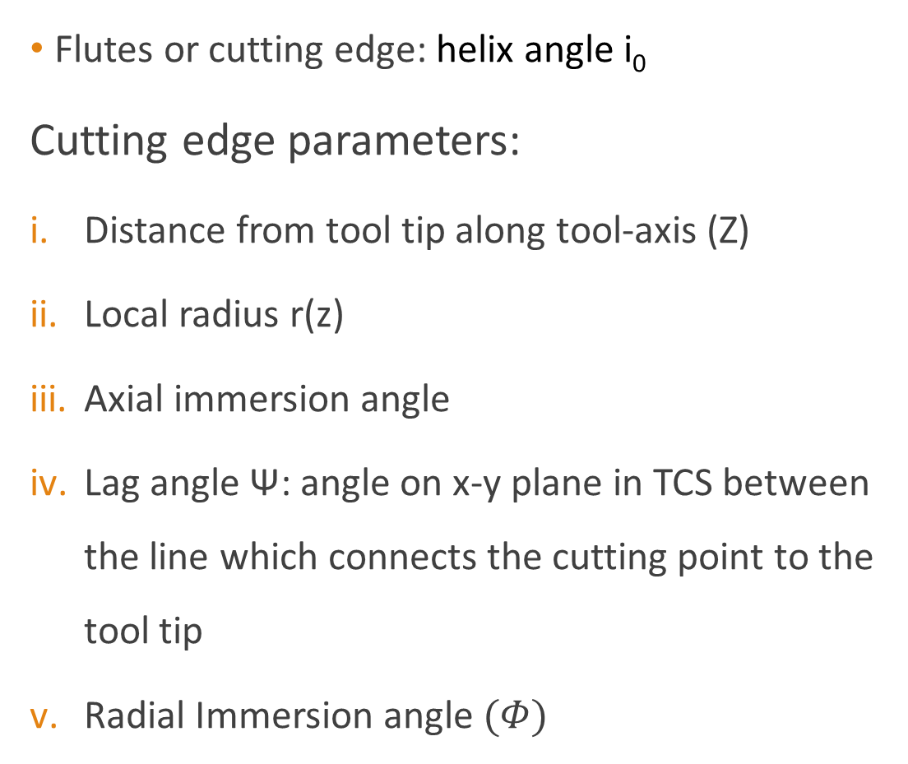
STEP 1: TOOL ENVELOPE FORMULATION
Flutes or cutting edge: helix angle i₀
Cutting edge parameters:
Distance from tool tip along tool-axis (Z)
Local radius r(z)
Axial immersion angle
Lag angle Ψ: angle on x-y plane in TCS between the line which connects the cutting point to the tool tip
Radial Immersion angle $(Φ)$
Helical cutting edges on ball end mill envelope

Slide 14
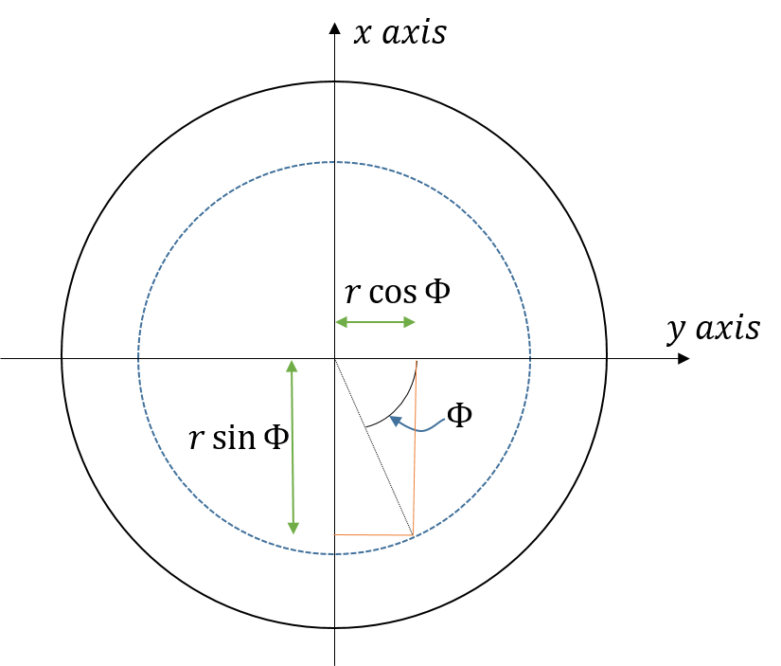
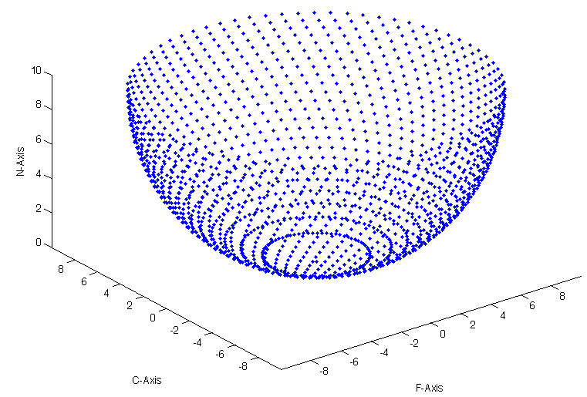
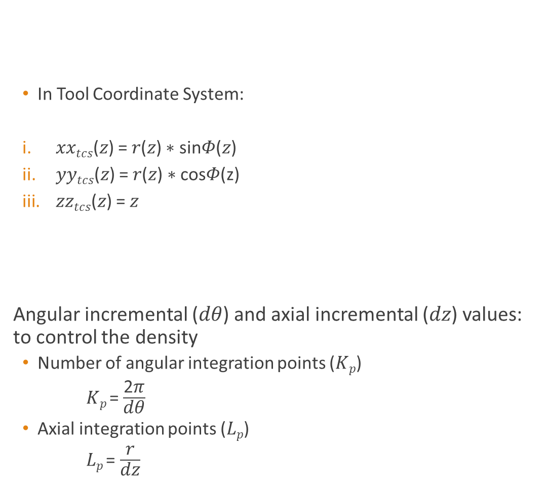
STEP 2: DISCRETIZATION OF SURFACE POINTS
In Tool Coordinate System:
𝑥𝑥_{𝑡𝑐𝑠}(𝑧) = 𝑟(𝑧) ∗ sin𝛷(𝑧)
𝑦𝑦_{𝑡𝑐𝑠}(𝑧) = 𝑟(𝑧) ∗ cos𝛷(z)
𝑧𝑧_{𝑡𝑐𝑠}(𝑧) = 𝑧
Angular incremental (𝑑𝜃) and axial incremental (𝑑𝑧) values: to control the density
Number of angular integration points (𝐾_{𝑝})
𝐾_{𝑝} = $\frac{\text{2}\text{π}}{\text{d}\text{θ}}$
Axial integration points (𝐿_{𝑝})
𝐿_{𝑝} = $\frac{\text{r}}{\text{dz}}$
Discretized points in FCN coordinate system envelope

Slide 15
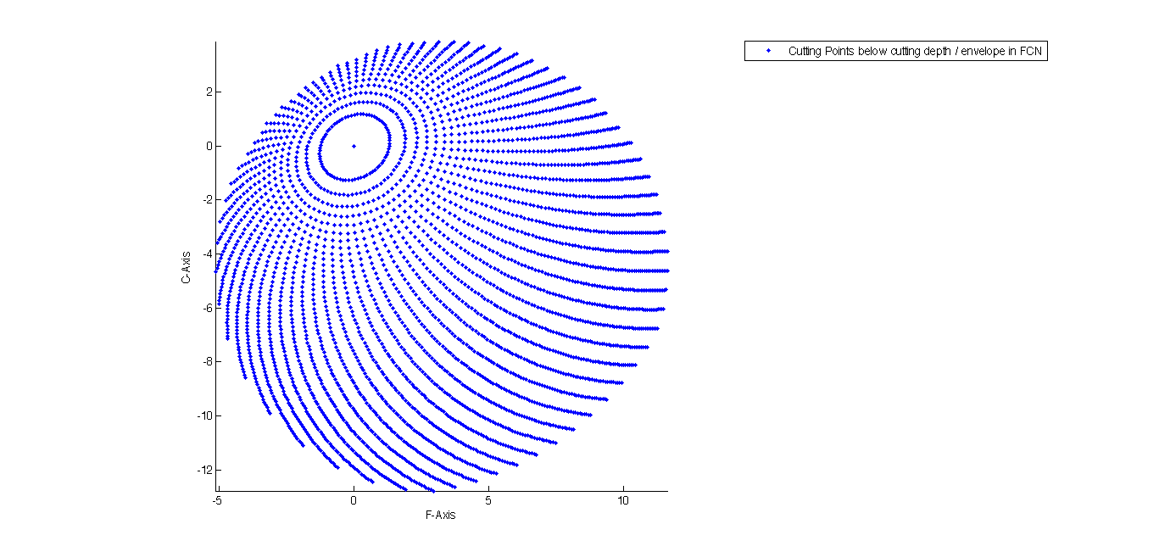
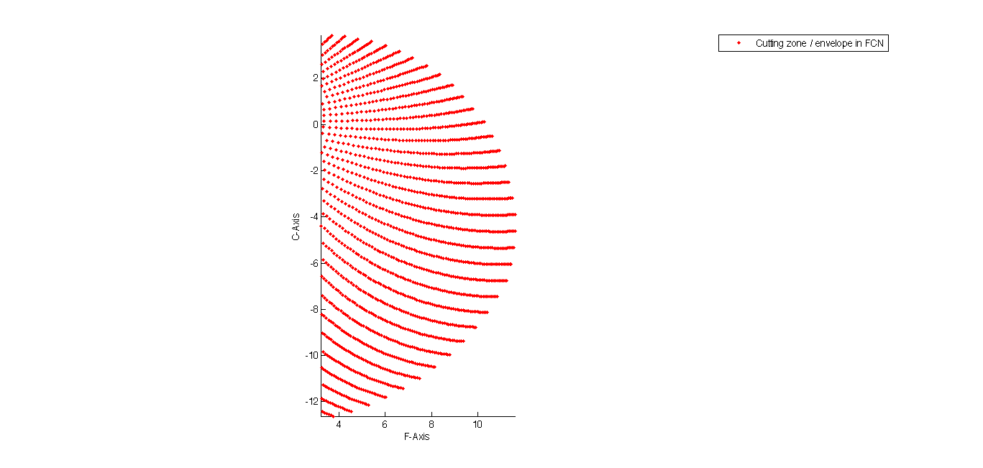
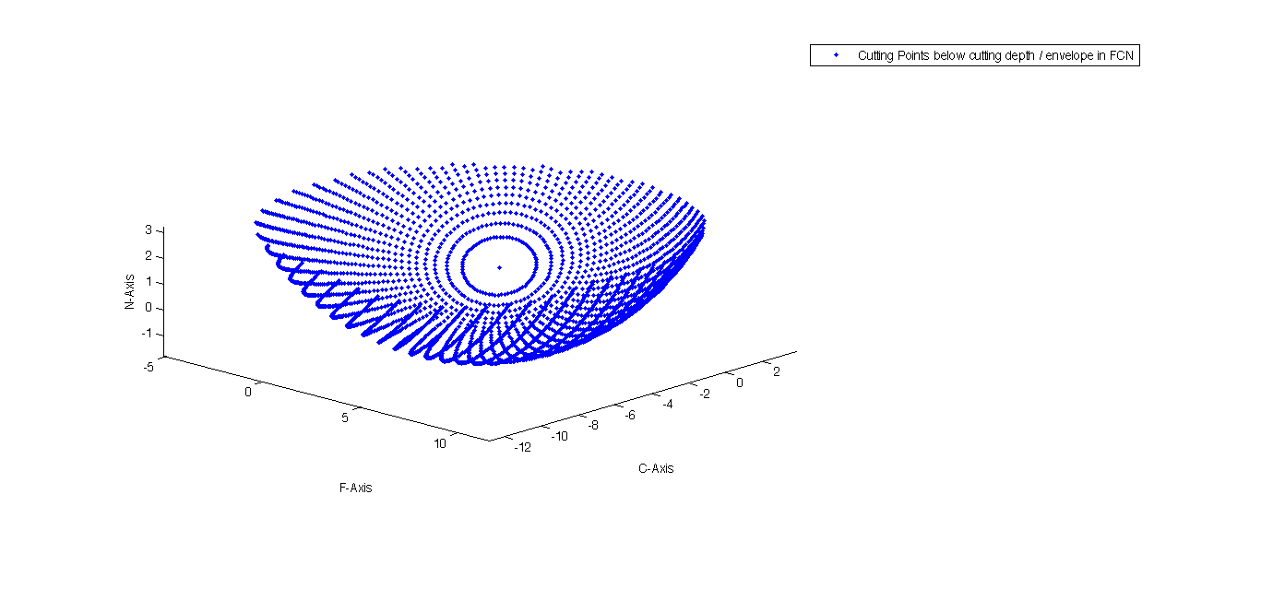
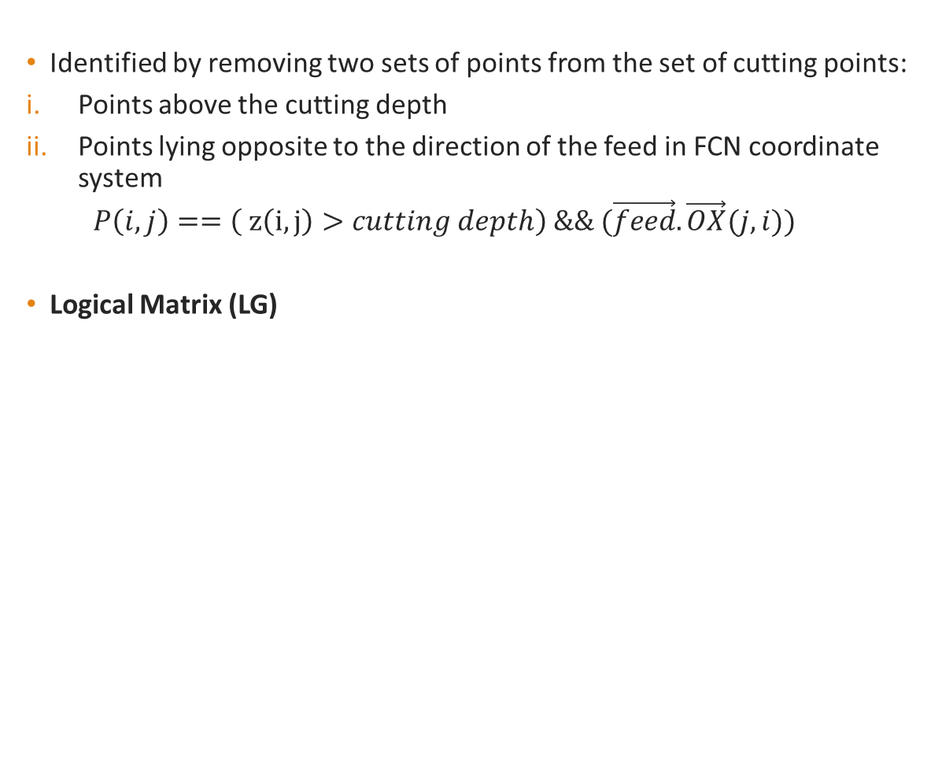
STEP 3: IDENTIFICATION OF CUTTING ZONE
Identified by removing two sets of points from the set of cutting points:
Points above the cutting depth
Points lying opposite to the direction of the feed in FCN coordinate system
$$P\left(i,j\right)==\left( z\left(i,j\right)>cutting depth\right) \&\& (\vec{feed}.\vec{OX}(j,i))$$
Logical Matrix (LG)
Discretized points in FCN coordinate system envelope
Top view of discretized points below the cutting depth
for -20⁰ lead 30⁰ tilt
Top view of discretized points in the cutting zone
for -20⁰ lead 30⁰ tilt

Slide 16
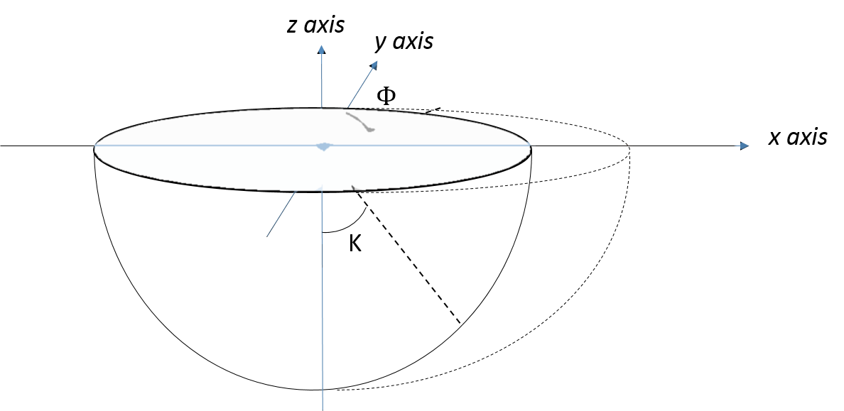
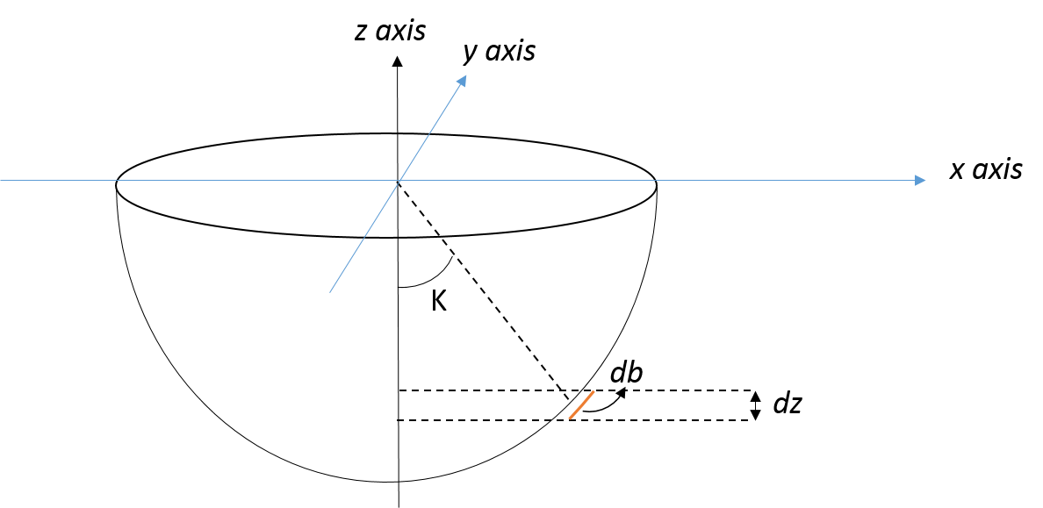
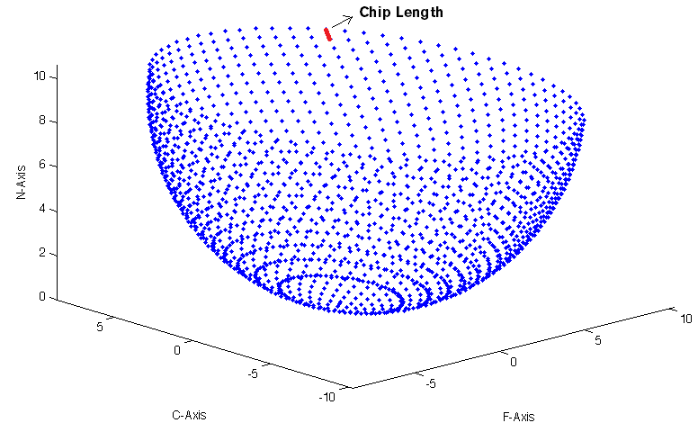
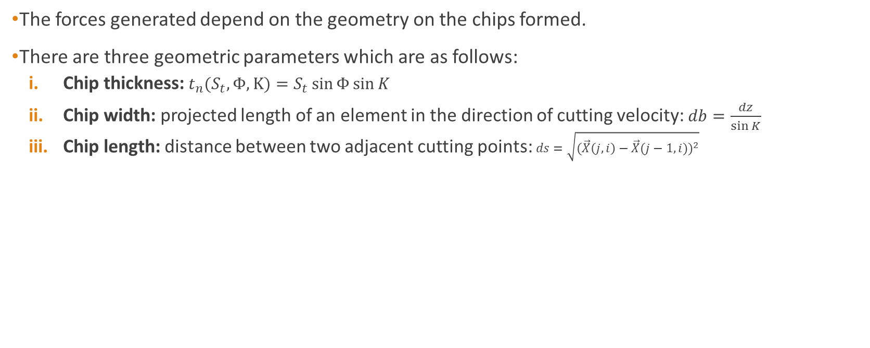
STEP 4: CHIP DIMENSIONS
The forces generated depend on the geometry on the chips formed.
There are three geometric parameters which are as follows:
Chip thickness: $t_{n}(S_{t},Φ,K)=S_{t}\sin{Φ}\sin{K}$
Chip width: projected length of an element in the direction of cutting velocity: $db=\frac{dz}{\sin{K}}$
Chip length: distance between two adjacent cutting points: $ds=\sqrt{{(\vec{X}\left(j,i\right)−\vec{X}(j−1,i))}^{2}}$

Slide 17
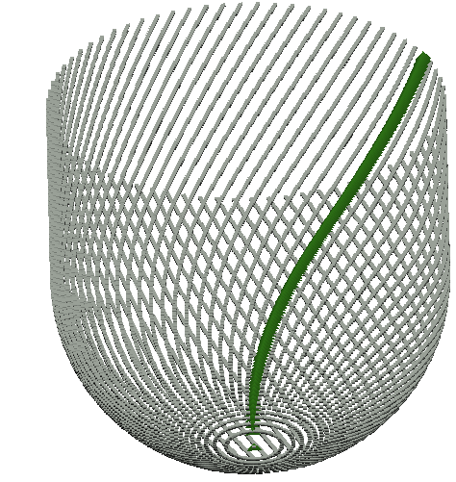
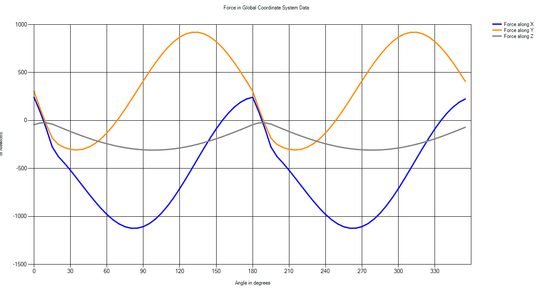
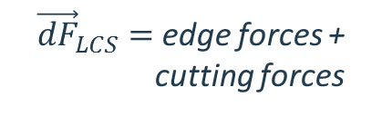



STEP 5: COMPUTATION OF FORCES
radial
tangential
axial
${\vec{dF}}_{LCS}=$ edge forces + cutting forces
Y
Z
X
Forces in FCN coordinate system
${\vec{dF}}_{TCS}=[A]$X${\vec{dF}}_{LCS}$
$${\vec{F}}_{TCS}=\sum{\vec{{dF}_{TCS}}}$$
C
F
N
$${\vec{F}}_{FCN}=\left[T\right]X{\vec{F}}_{TCS}$$

Slide 18
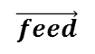
Model 2: Ball-End Mill Cutting Planar Surface
$$Z′$$
$$\vec{feed}$$
$$Cutting depth$$

Slide 19
Model 2: Ball-End Mill Cutting Planar Surface
Previous model is no longer valid:
Depth is continuously changing due to vertical feed
Engagement region is dynamic (updated at every angular movement)
Chip thickness value is no longer valid
Changes from previous model:
Engagement region determination methodology
Global Coordinate System
Chip dimensions calculation

Slide 20
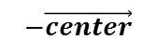
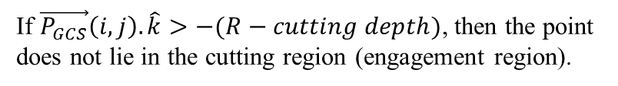
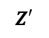
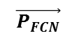
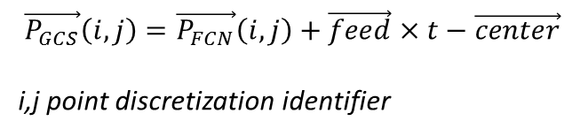
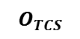
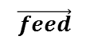
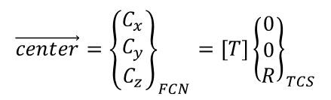
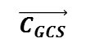
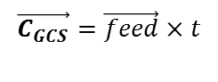
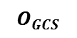

Engagement region determination methodology
Step 1: Geometry Check
Z
GCS: Global Coordinate System
$$\vec{C_{GCS}}=\vec{feed}×t$$
$$O_{GCS}$$
$$\vec{C_{GCS}}$$
$$Z′$$
$$\vec{center}={\left\{\begin{matrix}C_{x} \\ C_{y} \\ C_{z}\end{matrix}\right\}}_{FCN}=\left[T\right]{\left\{\begin{matrix}0 \\ 0 \\ R\end{matrix}\right\}}_{TCS}$$
$$\vec{feed}$$
$$\vec{P_{GCS}}$$
$$\vec{P_{GCS}}\left(i,j\right)=\vec{P_{FCN}}\left(i,j\right)+\vec{feed}×t−\vec{center}$$
i,j point discretization identifier
$$−\vec{center}$$
$$\vec{P_{FCN}}$$
If $\vec{P_{GCS}}\left(i,j\right).\hat{k}>−(R−cutting depth)$, then the point does not lie in the cutting region (engagement region).
$$Cutting depth$$
$$O_{TCS}$$

Slide 21
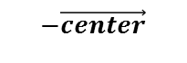
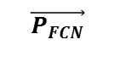
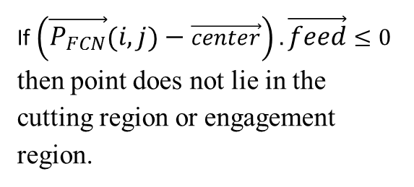

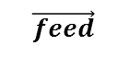
Engagement region determination methodology
Step 2: Surface normal vector check
If$\left(\vec{P_{FCN}}\left(i,j\right)−\vec{center}\right). \vec{feed}≤0$ then point does not lie in the cutting region or engagement region.
$$\vec{feed}$$
$$θ$$
$$−\vec{center}$$
$$\vec{P_{FCN}}$$

Slide 22
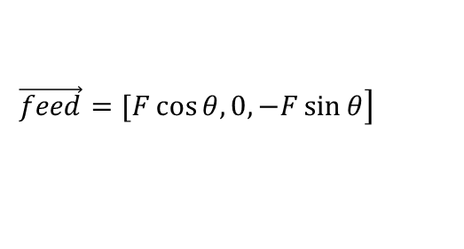
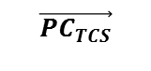

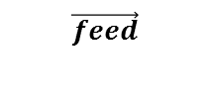
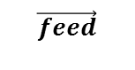
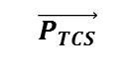
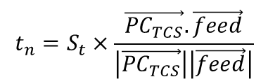
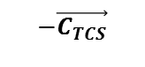
Chip Thickness calculation
$$\left.\vec{feed}=[F\cos{θ, 0, −F\sin{θ}}\right]$$
C
X
$$\vec{{PC}_{TCS}}$$
$$t_{n}=S_{t}×\frac{\vec{{PC}_{TCS}}.\vec{feed}}{\left|\vec{{PC}_{TCS}}\right|\left|\vec{feed}\right|}$$
$$θ$$
$$\vec{feed}$$
$$−\vec{C_{TCS}}$$
tn
$$\vec{feed}$$
$$\vec{P_{TCS}}$$
St
-Z
$$\vec{P_{TCS}}=\left[R\sin{𝒦}\sin{Φ},R\sin{𝒦}\cos{Φ},{R−R\cos{𝒦}}\right]$$

Slide 23
Model 3: General Milling Tool Cutting Planar Surface
Previous model is no longer valid:
Tool surface envelope
Engagement region determination methodology (tool center is not defined)
Chip thickness calculation methodology
Extensions
Non-planar surfaces
Surface Roughness

Slide 24
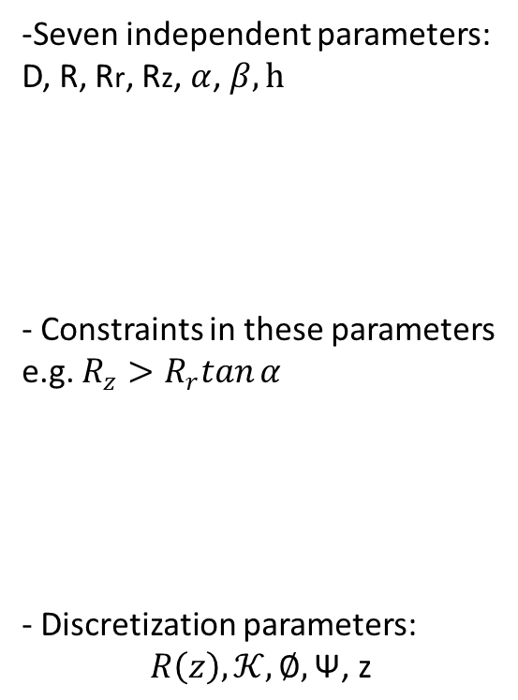
Tool Surface Envelope declaration
Z
-Seven independent parameters:
D, R, Rr, Rz, $α$, $β, h$
- Constraints in these parameters
e.g. $R_{z}>R_{r}tan{α}$
- Discretization parameters:
$$R\left(z\right), 𝒦,∅,\text{Ψ}\text{, }\text{z}$$
β
Rr
h
R
Rz
α
u
D

Slide 25
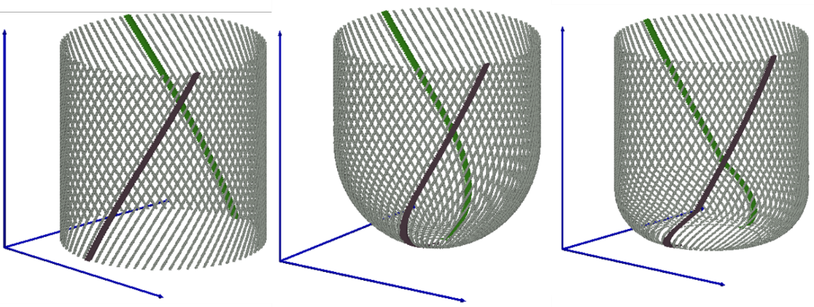
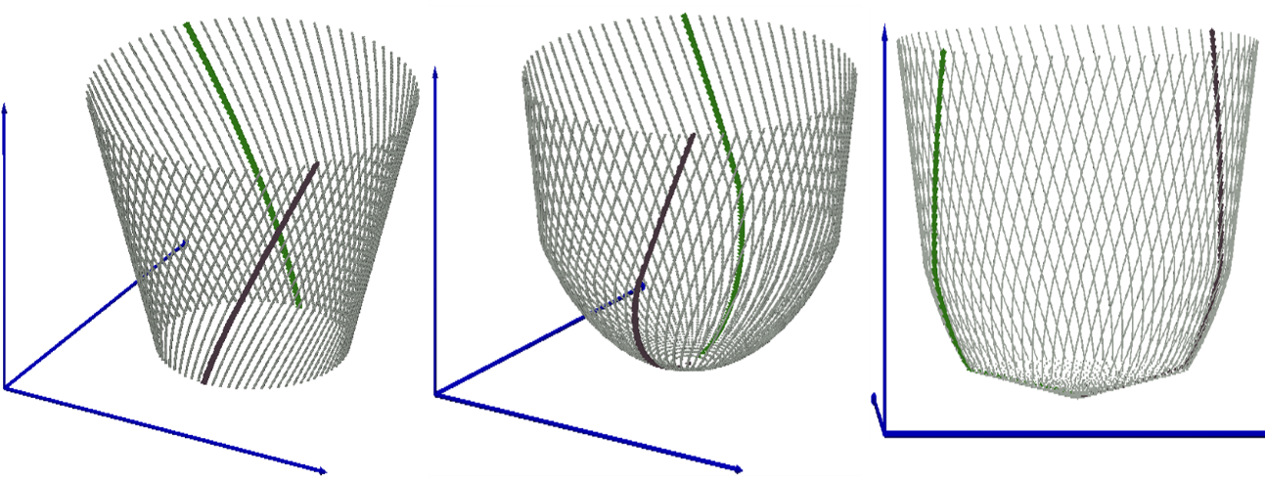
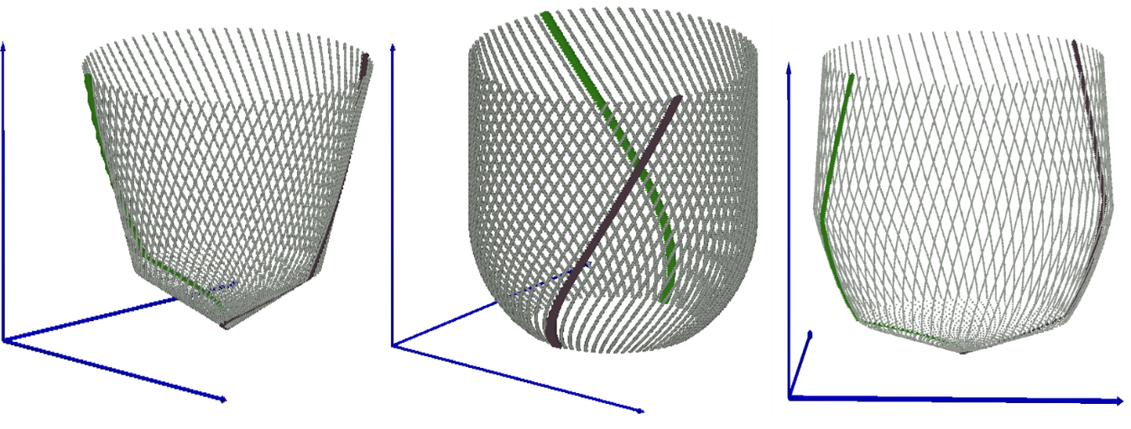
Discretization of Surface
Nine Commonly used tools:
Cylindrical-end Mill
Ball-end Mill
Bull Nose-end mill
Taper-end mill
Taper ball-end mill
Cone-end mill
Rounded-end mill
Inverted cone-end mill

Slide 26

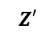
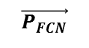
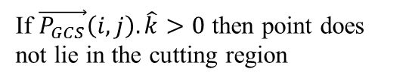
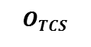






Engagement region determination methodology
Step 1: Geometry Check
GCS: Global Coordinate System
Z
$$B_{t}=B_{0}+\vec{feed}×t$$
$$Z′$$
$$O_{GCS}$$
$$\vec{P_{GCS}}\left(i,j\right)=\vec{P_{FCN}}\left(i,j\right)+B_{t}$$
$$\vec{P_{GCS}}$$
$$\vec{feed}$$
$$\vec{B_{t}}$$
$$\vec{P_{FCN}}$$
If $\vec{P_{GCS}}\left(i,j\right).\hat{k}>0$ then point does not lie in the cutting region
$$Cutting depth$$
$$O_{TCS}$$

Slide 27









Chip Thickness calculation
$$𝒦−Axial immersion angle$$
Z
$$\left.\vec{N_{TCS}}=[\sin{𝒦}\sin{Φ},\sin{𝒦}\cos{Φ},{−\cos{𝒦}}\right]$$
$${\left\{\begin{matrix}N_{x} \\ N_{y} \\ N_{z}\end{matrix}\right\}}_{FCN}=\left[T\right]{\left\{\begin{matrix}\sin{𝒦}\sin{Φ} \\ \sin{𝒦}\cos{Φ} \\ −\cos{𝒦}\end{matrix}\right\}}_{TCS}$$
Chip thickness is the component of $\vec{S_{t} }$
along the surface normal vector at the point.
$$t_{n}\left(S_{t},Φ,𝒦\right)=S_{t}×\frac{\vec{N_{FCN}}.\vec{feed}}{\left|\vec{feed}\right|}$$
$$\vec{feed}$$
$$\vec{S_{t}}$$
$$𝓚$$
$$\vec{N_{FCS}}$$

Slide 28








Engagement Zone for Non-Planer Surfaces
Z
$$Z′$$
$$O_{GCS}$$
$$\vec{P_{GCS}}$$
$$\vec{feed}$$
$$\vec{B_{t}}$$
$$\vec{P_{FCN}}$$
$$O_{TCS}$$
$$Non−Planer$$
$$surface$$

Slide 29


Engagement Zone for Non-Planer Surfaces
Case: Step Surface
The point $P\left(i,j\right)$ does not lie in the engagement region in the following conditions:
If $P_{x}≤X$ and $P_{z}>0$
If $P_{x}>X$ and $P_{z}>Z$

Slide 30









Step Over and Surface Roughness
First Cut, following cut, step over, scallop height
$$Z′$$
$$Z′′$$
Present cut
Previous cut
Z
$$d_{1}$$
t
$$\vec{P_{FCS}}$$
$$d_{2}$$
$$h_{s}$$
$$d_{3}$$
Y
$$(0,0)$$
$$(−s,0)$$

Slide 31
RESULTS AND VALIDATION

Slide 32

CASE: Inputs parameters: Diameter, D = 19.05mm Helix angle, i₀ = 30⁰ Rake angle, $α$ = 0⁰ Number of flukes, N_{f} = 1 Spindle speed, n=269 rpm Table feed, S_{t} = 13.6652 mm/min Depth of cut = 6.35mm Lead angle = 0⁰ Tilt angle = 0⁰
1 cutting edge
Variation of F, C and N forces with rotational angle
As the cutting edge starts coming out of the cutting region all the three components start tending to zero.
Ref: P. Lee and Y. Altintas, “Prediction of ball end milling forces of orthogonal cutting data”

Slide 33

CASE: Inputs parameters: Diameter, D = 19.05mm Helix angle, i₀ = 30⁰ Rake angle, $α$ = 0⁰ Number of flukes, N_{f} = 1 Spindle speed, n=269 rpm Table feed, S_{t} = 13.6652 mm/min Depth of cut = 6.35mm Lead angle = 0⁰ Tilt angle = 0⁰
In this case, the ball-end tool has only 1 cutting edge.
Variation of F C and N forces with rotational angle
As the cutting edge starts coming out of the cutting region all the three components start tending to zero.

Slide 34


Determining Lead and Tilt Angles
As we increase the depth of cut, the lead and tilt angles also need to be increased (magnitude) to get the minimum value of Fxy_max
Depth of cut = 2.5mm
Lead and tilt angles for minimum force on
the cutting tool are 20⁰ and 4⁰ respectively.
Depth of cut = 5mm
Lead and tilt angles for minimum force on
the cutting tool are 34⁰ and 8⁰ respectively.

Slide 35
CONCLUSIONS AND FUTURE SCOPE

Slide 36

On hitting an step, the rate of change of forces in the starting zone is much more compared to later zone

Slide 37




Keeping all the machining parameters constant, inverted cone end mill experiences the maximum amount of resultant force and torque and cone end mill experiences the minimum amount of resultant force and torque

Slide 38




X
$$\vec{feed}$$
$$θ$$
$$\vec{feed}$$
-Z
Forces and torque required in the case when tool has horizontal as well as vertical feed of is much larger when the case when tool has only horizontal feed

Slide 39

Number of flutes = 2
Number of flutes = 3
As the number of flutes increase, the force and torque experienced by the tool are more evenly distributed

Slide 40
SHORTCOMINGS OF THE CURRENT MODEL
Orthogonal Cutting Data is based on empirical results obtained after conducting experiments and then fitting a regression model, Hence the results obtained from OCD are not necessarily accurate.
The model has been developed for only Titanium alloy.
The model considers the tool is always ideal, rigid, edges are always sharp and do not wear while machining, whereas in real life tool wears out due the cyclic force experienced.
Chips are considered to be in most ideal form also known as undeformed chips. In reality, chips dimensions are different and chips interfere in cutting process.

Slide 41

FUTURE SCOPE
The current model can be extended to automate the selection of tilt angle and step over to optimize the machining time and surface roughness.
Using this model, the energy lost in cutting ($power=ω×torque$) and energy dissipated as heat can be known, the model can be extended to incorporate lubrication and cooling aspects.
Automation can be done in terms of path selection of the tool given the initial and final workpiece model cutting within the surface tolerance limit.
CAM/CAD models can be integrated with the current model. Workpiece surface can be dynamically updated and the combination of the lead and tilt angles can be obtained at each point of time to optimize the entire process in terms of machining time.
This model can become the input for vibration and chatter modeling of the machining processes

Slide 42
THANK YOU

